Slide 1
Computer Systems Computer Systems Pitch lecture, June 2 2023
Lecture:
Michael Kirkedal Thomsen
Other on the course
Finn Schiermer
David Marchant
With some slides by:
Randal E. Bryant and David R. O’Hallaron

Slide 2
CompSys
På første år har I set programmer som abstrakte modeller
Abstrakte datatyper
Asymptotisk analyse
Programmer skal dog afvikles på en fysisk maskine
CompSys: Vi skal forstå hvad der virkeligt foregår i en computer
Forstå low-level abstraktioner
Machine Architecture, Memory hierarchy, Operating Systems, Computer Networks, and Encryption.
Blive bedre til at skrive gode programmer
Kan finde og fjerne bugs
Kan forstå og forbedre performance
Notes:
Programmering er et vigtigt værktøj

Slide 3

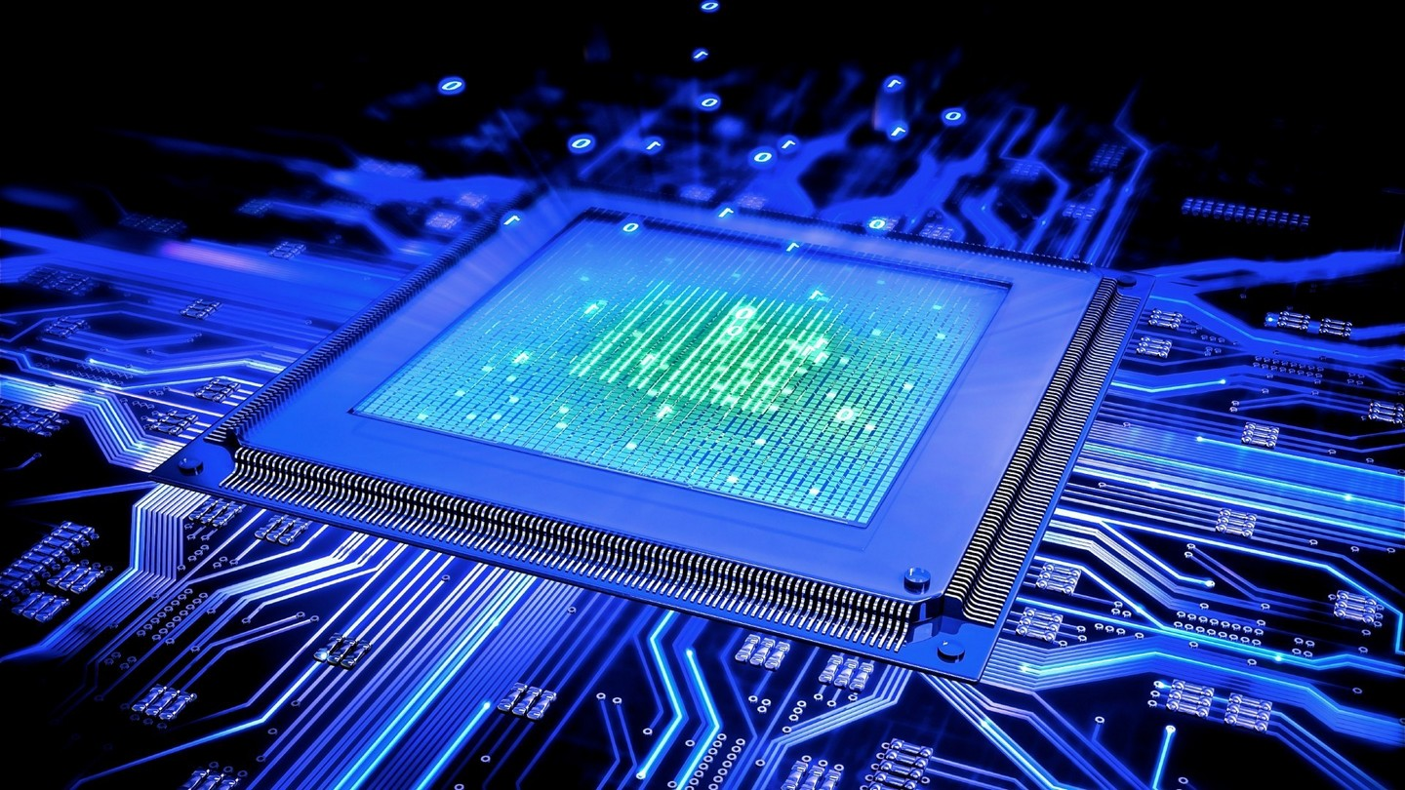

What is a computer system?
What to you is a computer system? What does it effect?
CPU, logic gate, transistor, RAM, memory hierarchy, virtual memory, process, thread, network, disk, I/O, http, TCP/IP, RSA, bus, cache, WiFi, switch, internet, synchronization, pipeline,..

Slide 4
Simple example
What happens here?
Indexes are switched
Data representation
Memory hierarchy
Hidden abstractions – The real world is messy

Slide 5
Course Theme: Abstraction Is Good But Don’t Forget Reality
Carnegie Mellon
Most CS courses emphasize high-level abstraction
Abstract data types
Asymptotic analysis
These abstractions have limits
Especially in the presence of bugs
Need to understand details of underlying implementations
Useful outcomes from taking CompSys
Knowledge about concepts of (low-level abstractions)
Machine Architecture, Memory hierarchy, Operating Systems, Computer Networks, and Encryption.
Become more effective programmers
Able to find and eliminate bugs efficiently
Able to understand and tune for program performance

Slide 6
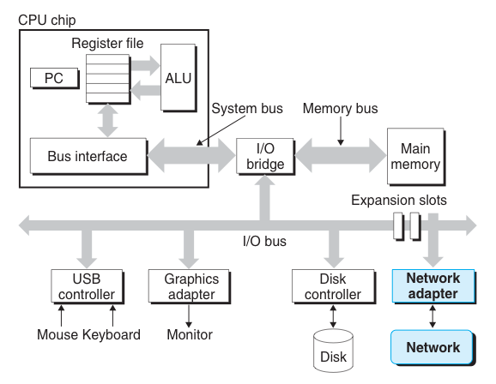
Computer system
Carnegie Mellon
How to interface with computer system
Learn the difference abstractions and how they are implemented
Understand how security can be improved

Slide 7
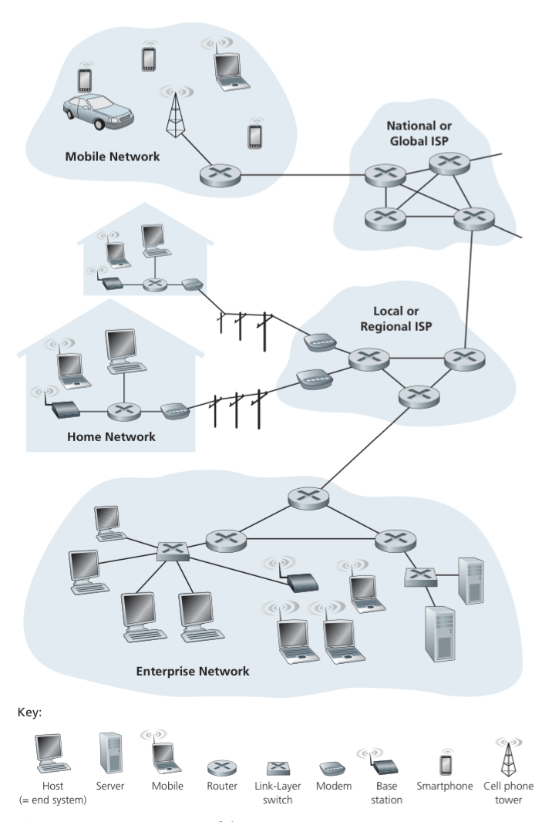
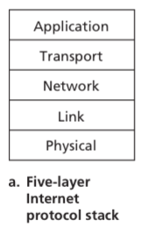
The Network
Carnegie Mellon

Slide 8
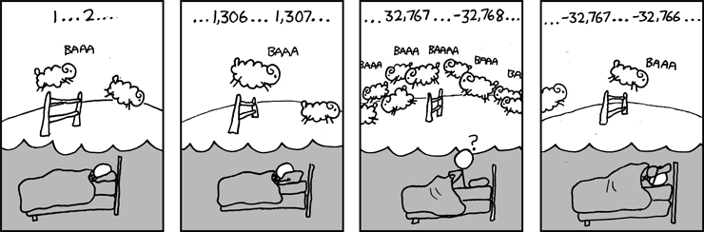
Great Reality #1: Ints are not Integers, Floats are not Reals
Carnegie Mellon
Example 1: Is x² ≥ 0?
Float’s: Yes!
Int’s:
40000 * 40000 ➙ 1600000000
50000 * 50000 ➙ ??
Example 2: Is (x + y) + z = x + (y + z)?
Unsigned & Signed Int’s: Yes!
Float’s:
(1e20 + -1e20) + 3.14 --> 3.14
1e20 + (-1e20 + 3.14) --> ??
Source: xkcd.com/571

Slide 9
Great Reality #2: You’ve Got to Know Assembly
Carnegie Mellon
Chances are, you’ll never write programs in assembly
Compilers are much better & more patient than you are
But: Understanding assembly is key to machine-level execution model
Behavior of programs in presence of bugs
High-level language models break down
Tuning program performance
Understand optimizations done / not done by the compiler
Understanding sources of program inefficiency
Implementing system software
Compiler has machine code as target
Operating systems must manage process state
Creating / fighting malware
x86 assembly is the language of choice!

Slide 10
Great Reality #3: Memory Matters Random Access Memory Is an Unphysical Abstraction
Carnegie Mellon
Memory is not unbounded
It must be allocated and managed
Many applications are memory dominated
Memory referencing bugs especially pernicious
Effects are distant in both time and space
Memory performance is not uniform
Cache and virtual memory effects can greatly affect program performance
Adapting program to characteristics of memory system can lead to major speed improvements

Slide 11
Memory Referencing Bug Example
Carnegie Mellon
typedef struct {
int a[2];
double d;
} struct_t;
fun(0) ➙ 3.14
fun(1) ➙ 3.14
fun(2) ➙ 3.1399998664856
fun(3) ➙ 2.00000061035156
fun(4) ➙ 3.14
fun(6) ➙ Segmentation fault
Explanation:
Critical State | 6
? | 5
? | 4
d7 ... d4 | 3
d3 ... d0 | 2
a[1] | 1
a[0] | 0
Location accessed by fun(i)
struct_t

Slide 12
Great Reality #4: There’s more to performance than asymptotic complexity
Carnegie Mellon
Constant factors matter too!
And even exact op count does not predict performance
Easily see 10:1 performance range depending on how code written
Must optimize at multiple levels: algorithm, data representations, procedures, and loops
Must understand system to optimize performance
How programs compiled and executed
How to measure program performance and identify bottlenecks
How to improve performance without destroying code modularity and generality

Slide 13
Great Reality #5: Computers do more than execute programs
Carnegie Mellon
They need to get data in and out
I/O system critical to program reliability and performance
They communicate with each other over networks
Many system-level issues arise in presence of network
Concurrent operations by autonomous processes
Coping with unreliable media
Cross platform compatibility
Complex performance issues

Slide 14
Course Perspective
Carnegie Mellon
Course is Programmer-Centric
Purpose is to show that by knowing more about the underlying system, one can be more effective as a programmer
Enable you to
Write programs that are more reliable and efficient
Incorporate features that require hooks into OS
E.g., concurrency, signal handlers’
Information on Absalon Course Page, and
https://github.com/diku-compSys/compSys-e2023-pub

Slide 15
Preparation
Carnegie Mellon
Programming is a craft
It is important that you practice it
Keeping your C# up-to-date
DIKU Summer of Programming 2021
https://github.com/diku-summer-programming/DSoP21
Edabit
https://edabit.com/challenges/csharp
Programmr
http://www.programmr.com/exercises?lang=csharp

